Slide 1

Magic INTRO and cheat
James E. Stine, Jr.
Edward Joullian Endowed Chair in Engineering
Oklahoma State University
Electrical and Computer Engineering Department
Stillwater, OK 74078 USA
james.stine@okstate.edu

Slide 2
Announcements
HW 2 is due soon, so make sure you get started.
If you have questions, please post them to piazza and do not send me E-mail.
It is not that I do not like your Emails – I actually like that you E-mail me, however, it has several benefits.
It will probably be answered faster as we have several TAs helping.
Other people can learn from your problems.
If you do not want to post to piazza, because your name will appear, you can always post anonymously.
You can also post privately if you have a problem you only want me to see (again, you can also post privately so your name does not appear).

Slide 3
Early VLSI system
https://en.wikipedia.org/wiki/Calma
Calma → Valid → Cadence Design Systems

Slide 4
Another Early VLSI System

Slide 5
Early VLSI System

Slide 6
Using Early CAD Systems
https://en.wikipedia.org/wiki/Computervision

Slide 7
What changed?
What changed was the invention of the PC.
Thank Ed Roberts!
It made it much easier and cheaper to run software for VLSI.
Open-source
Open-source software (i.e., software developed by a community of developers) helped to really develop debugged software.
It also allowed others to flush out problems.
Magic
Magic was originally written by John Ousterhout from UCB.
It languished around until probably mid 1980s when my friend Tim Edwards decided to take on revitalizing the software.
It goes through lots of revisions daily and is open-source.
http://www.opencircuitdesign.com
Linux
Linux also changed things by having a reliable Operating System (OS) that all can use (and that’s free and open-source!).

Slide 8
Caveat Emptor
Layout is essential in any fabrication process, but you should have a game plan starting out.
For Integrated Circuits and layout, a stick diagram to start out is essential.
Its even better if you have some idea of the sizes involved.
Always remember that layoiut is a time sink so having an idea where to go is important.
Scripts are essential in any EDA tool and using them really saves you time.
If you are not sure this is the way to do something, please ask.
Post on piazza!
Show a screen shot of your problem and issues!

Slide 9
Mouse
Your mouse or puck is the key to any layout tool.
Get used to handling and using your mouse within magic.
Left Click
Lower left hand corner of rectangle
Right Click
Upper right hand corner of rectangle
Middle Click
Will paint inside the box what layer your mouse is over (trick and perhaps best understood later when you understanding more commands).
For example, if you move your mouse over poly and click the middle mouse button, it will paint poly in that box!

Slide 10
Commands
All error messages pertaining to the design are also displayed in this text window.
Always make sure you see the text window!
Commands can be done several ways
By pressing buttons on the mouse in either the graphics or text window.
By typing long commands on the keyboard, where long commands are preceded by a colon ":".
By typing single-character macros on the keyboard.

Slide 11
Box
Grid is key and always make sure you are in BOX mode!
The BOX tool is the default tool and is indicated by a crosshair cursor. It is used to position a graphical outline box that layers can be painted and erased in. This is the tool used for all basic drawing tasks and is your layout workhorse. Use of the BOX tool is described below in the Basic drawing section and in more detail in the MAGIC Tutorial #1: Getting Started and MAGIC Tutorial #2: Basic Painting and Selection.
:tool box
The SPACE bar is also enabled to cycle through each tool set (e.g., box).
Wiring
Netlist
Pick
Box

Slide 12
Useful Global Commands
:quit quits MAGIC and exits to the shell.
:help command prints out a brief description of all the commands or the specified command.
:load circuit-name loads circuit-name into the window; if circuit-name doesn't exist, MAGIC creates a new empty circuit.
:save circuit-name saves all the changes to the circuit.
:view or v fills the active drawing window with everything painted thus far in the current design.
:f or Select Cell highlights the whole area of your layout with a box.
:grid or g toggles a visible screen grid in the layout area on or off. The grid is useful for lining up various cells, wires, and sections of a schematic. A grid of n lambda by n lambda can be displayed by entering the :grid n command. The g macro is useful shorthand.
If you do this by mistake, type :grid off
:zoom amount zooms in and out of the active window by a factor of amount, i.e. :zoom 2 zooms in twice as much, and :zoom 0.5 zooms out twice as much. The z (small z) macro zooms out to fit the box on the paint window. The Z (uppercase Z) macro zooms in the same as the ":zoom 2" command.
:macro displays all current macros (not useful)

Slide 13
Paint
The two basic layout operations are painting and erasing. They can be invoked using the :paint and :erase commands, or by using the mouse buttons.
:paint layers paints rectangular regions as specified by the box region in the graphical window.
:erase layers deletes the specified layers from the region within the box.
The easiest way to paint and erase is with the mouse buttons!

Slide 14
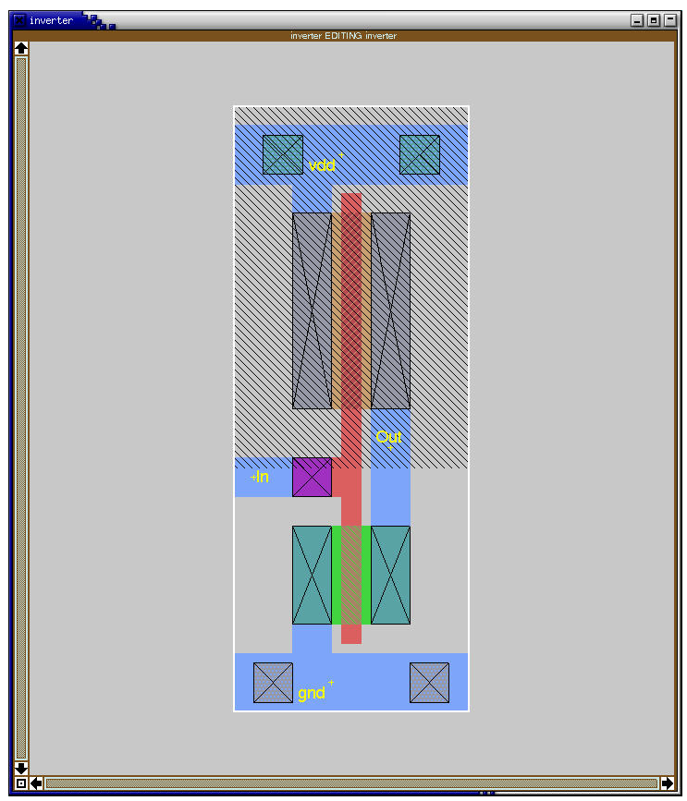
Main colors
Polysilicon
:paint poly
n+/p+
:paint ndiff/pdiff
n/p-contact
:paint ndc/pdc
Metal (according to layer!)
:paint m1
Contact to substrate (n/p)
:paint nwc/pwc

Slide 15
Super Editing commands
This one will take time, but its so cool its worth mentioning over and over!
Place box over the area you want selected.
:select or “a” (macro)
QWER move by 1 lambda in different directions.
You need to get feel of movements
You can also copy and stretch stuff, but this is more difficult.
Don’t forget
:sideways
:clockwise
:upsidedown
:delete (macro “d”)
:copy (macro “c”)
:erase
:undo (macro “u”)
:redo (macro “U”)
You can also use the “.” (dot) macro to repeat the last command

Slide 16
Labels
Don’t forget to label your items (:label labelname)
where labelname can be any valid UNIX designation, but a good convention is to use labels that will correspond to circuit signals and make the layout more readable in a printout.
In particular, it is necessary to label the supply wires (nodes) as Vdd! and GND! typed exactly as indicated. The ! mark - commonly known to programmers as "bang" - indicates that the node is global and spans the entire drawing.
Why one label is all caps and the other not is a matter of constant debate and dates back to some obscure historical origin that not even the finest of long-hair Internet hackers can agree on.

Slide 17
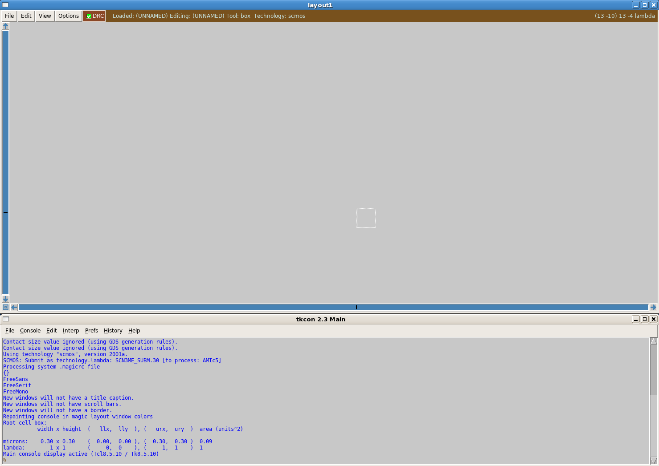
DRC
:drc why
Design Rule Checking is performed automatically in MAGIC and is one of its most powerful features.
Technology stated when starting magic!

Slide 18
Summary
Magic takes time to learn, but its easy to learn.
Magic is also, unfortunately, a TIME SINK!
Don’t give into it – always have a stick diagram and use it to create your design!
Keep them in your lab notebook or some other place of storage.
Ask questions!
Piazza seems to be a great place for this!
Magic tutorial
http://vcag.ecen.okstate.edu/wiki
YouTube channel
https://www.youtube.com/user/jlstine/

